Slide 1
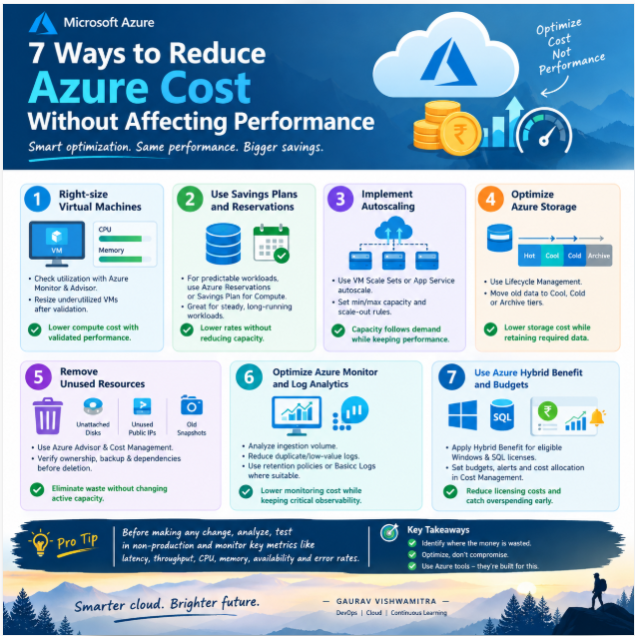
7 Ways to Reduce Azure Costs Without Compromising Performance 🚀
☁️ 7 Ways to Reduce Azure Costs Without Compromising Performance 🚀 — With Practical Azure Portal Locations
Cloud cost optimization is not about blindly reducing VM sizes. It’s about identifying waste, optimizing resource utilization, and maintaining performance, availability, and scalability.
As a DevOps Engineer, understanding where to find cost optimization opportunities in Azure is an important skill.
Here are 7 practical techniques you can implement 👇
🔹 1. Right-Size Virtual Machines
📍 Where to check: Azure Portal → Azure Advisor → Cost → Recommendations
Also check: Virtual Machines → Your VM → Monitoring → Metrics
✅ Analyze CPU and memory utilization before resizing VMs. Validate the new size against workload requirements.
🔹 2. Use Reservations & Savings Plans
📍 Where to check: Azure Portal → Cost Management + Billing → Savings plans / Reservations
✅ Evaluate predictable workloads for commitment-based pricing. Confirm eligibility, usage patterns, and commitment terms before purchasing.
🔹 3. Implement Autoscaling
📍 Where to check:
Virtual Machine Scale Sets → Scaling
App Service → Scale out (App Service plan)
✅ Configure minimum and maximum capacity, scale-out thresholds, and scale-in rules to match workload demand.
🔹 4. Optimize Azure Storage
📍 Where to check: Storage Accounts → Your Storage Account → Data Management → Lifecycle Management
Also check: Storage Account → Monitoring → Metrics
✅ Move infrequently accessed data to suitable Cool, Cold, or Archive tiers based on access requirements, retrieval costs, and recovery needs.
🔹 5. Remove Unused Resources
📍 Where to check: Azure Advisor → Cost → Recommendations
Also check: Cost Management + Billing → Cost analysis
✅ Investigate unattached managed disks, unused public IPs, and unnecessary snapshots. Verify ownership, dependencies, and backup requirements before deletion.
🔹 6. Optimize Azure Monitor & Log Analytics
📍 Where to check: Log Analytics Workspaces → Your Workspace → Usage and estimated costs
Also check: Azure Monitor → Logs
✅ Identify high-volume log sources, reduce unnecessary ingestion, and configure appropriate retention settings without losing critical troubleshooting or security data.
🔹 7. Use Azure Hybrid Benefit & Cost Management
📍 Where to check:
Cost Management + Billing → Cost analysis
Cost Management + Billing → Budgets
Eligible VM or SQL resource → Configuration / Licensing options
✅ Review eligible existing Windows Server and SQL Server licenses, create budget alerts, and track actual versus forecast spending.
💡 BONUS: The Production-Safe Optimization Checklist
Before implementing any cost-saving change:
✔️ Analyze utilization and workload patterns
✔️ Validate changes in a non-production environment
✔️ Monitor latency, throughput, CPU, memory, and availability
✔️ Compare costs before and after optimization
✔️ Maintain rollback plans for production changes
🎯 The DevOps mindset:
Don't optimize cost at the expense of reliability.
Reduce waste. Improve utilization. Protect performance.
💬 Your turn: Which Azure cost optimization technique would you check first in a production environment?
#Azure #DevOps #AzureCloud #FinOps #CloudCostOptimization #CloudArchitecture #AzureMonitor #Terraform #ContinuousLearning

Slide 2
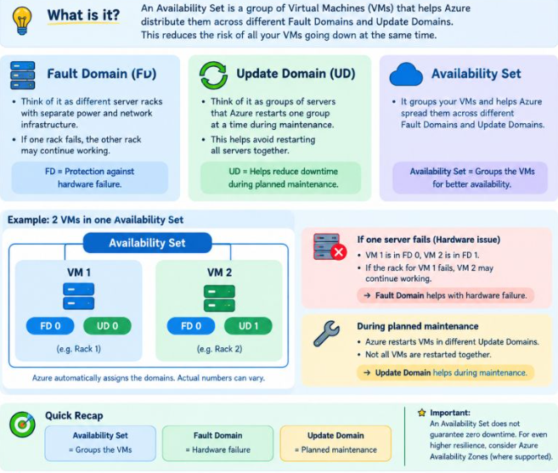
Azure Availability Set Explained with a Simple Example!
☁️ Azure Availability Set Explained with a Simple Example!
Imagine you have a website running on 2 Azure Virtual Machines (VMs).
What if one server fails? Or Azure needs to restart a server for maintenance?
🏢 1. Fault Domain (FD)
Think of it as different server racks with separate power and network infrastructure.
If one rack fails, the other rack may continue working.
👉 Fault Domain = Protection against hardware failure.
🔄 2. Update Domain (UD)
Imagine Azure needs to restart servers for planned maintenance.
Azure divides them into groups so that all servers are not restarted together.
👉 Update Domain = Helps reduce downtime during planned maintenance.
☁️ 3. Availability Set
It groups your VMs and helps Azure distribute them across Fault Domains and Update Domains.
Real-life example:
VM 1 → Fault Domain 0 + Update Domain 0
VM 2 → Fault Domain 1 + Update Domain 1
If one VM becomes unavailable, the other may continue serving users, provided the application is configured correctly.
🎯 Remember:
• Availability Set = Groups the VMs in the same data centre
• Fault Domain = Hardware failure
• Update Domain = Planned maintenance

Slide 3
Introduction
Good evening. I’m Gaurav Vishwamitra, a DevSecOps Engineer with over 14 years of IT experience in telecom domain, including 5 years of hands-on work building secure, automated cloud platforms on Azure.
I worked with enterprise architects on Azure Landing Zone design, covering management hierarchy, governance, security, networking, monitoring, backup, and disaster recovery. Once the HLD and LLD are approved, I automate the deployment so what is designed is exactly what runs in production.
My core strength is Terraform. I design infrastructure code to be modular and reusable, with remote state in Azure Storage using state locking, and I use for_each, nested maps, locals, and lifecycle controls so teams can onboard new environments quickly without duplicating code. I provision Azure IaaS, PaaS, and SaaS services this way.
I manage infrastructure CI/CD through GitHub and Azure DevOps YAML pipelines, with TFLint, TFSec, Checkov, Terratest, and Super-Linter validating every change before deployment. For applications, I build multi-stage pipelines for build, test, artifact publishing, and deployment to Azure VMs, VM Scale Sets, AKS, App Service, Container Apps, and Static Web Apps.
Security is built into every stage: SAST with SonarQube and Snyk, DAST with OWASP ZAP, and secret scanning with TruffleHog. I use Key Vault and Managed Identity to avoid hard-coded credentials, and I support teams with monitoring, troubleshooting, and release management.
My goal is always the same: help teams deliver faster, with consistency and security built in. I’m excited to bring this experience to your team. Thank you.

Slide 4
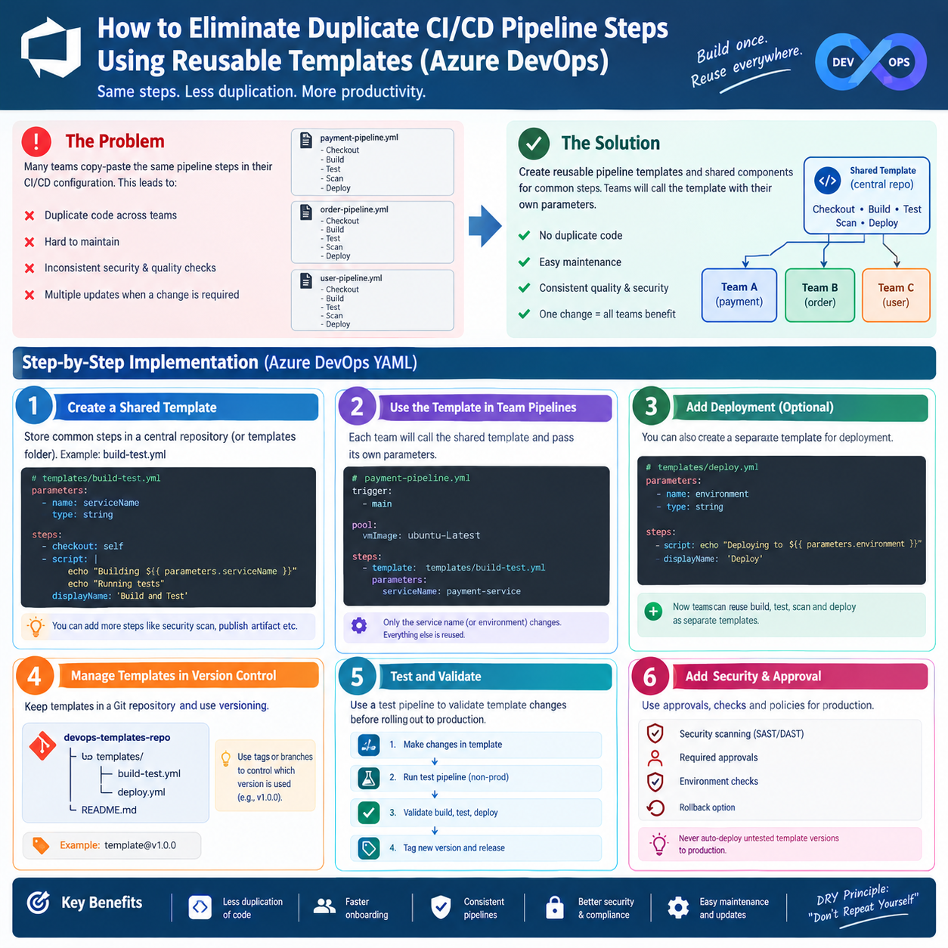
CI/CD Pipeline Steps Using Reusable Templates
🚀 How to Eliminate Duplicate CI/CD Pipeline Steps Using Reusable Templates
Many DevOps teams copy-paste the same pipeline steps across multiple projects. This creates maintenance overhead, inconsistent security checks, and unnecessary duplication.
💡 The solution? Reusable CI/CD templates.
Here’s how to implement them using Azure DevOps YAML:
✅ Step 1: Create a shared repository for common pipeline templates.
✅ Step 2: Extract reusable steps such as build, test, and security scanning into YAML templates.
✅ Step 3: Let teams reuse templates by passing parameters for application-specific configurations.
✅ Step 4: Manage templates in Git with proper versioning and controlled releases.
✅ Step 5: Test template changes in a non-production pipeline before rolling them out.
✅ Step 6: Enforce security scans, approval gates, and deployment policies.
🎯 Key Benefits:
Less duplicated code
Easier maintenance
Consistent quality and security
Faster onboarding for development teams
Better scalability across microservices
Remember: Build once. Reuse everywhere.
Follow the DRY principle — Don't Repeat Yourself.
#DevOps #AzureDevOps #CICD #CloudEngineering #Automation #PlatformEngineering #Kubernetes #DevSecOps

Slide 5
CI/CD Pipeline Steps Using Reusable Templates
I would reduce pipeline duplication by creating reusable CI/CD templates and shared components for common steps such as code checkout, build, testing, security scanning, and deployment.
I would store these templates in a centralized Git repository and allow teams to reuse them through parameters for application-specific configurations. I would also version the templates to ensure controlled updates and backward compatibility.
This approach improves maintainability, consistency, security, and developer productivity. Common changes can be implemented centrally instead of modifying every team's pipeline individually.
Hinglish mai:
Main pipeline duplication reduce karne ke liye reusable CI/CD templates banaunga. Common steps jaise build, testing, security scanning aur deployment ko centralized templates mein maintain karunga.
Teams in templates ko parameters ke through reuse karengi, jisse application-specific configurations alag rahengi aur common logic duplicate nahi hoga. Templates ko Git mein version control karunga aur changes ko properly test karke release karunga.
Isse maintenance easy hogi, sabhi teams mein consistency rahegi, security improve hogi aur pipeline changes ko centrally manage kar paayenge.
Interviewer ka follow-up question
Q: Agar central template mein bug aa gaya, toh sabhi teams ki pipelines fail ho sakti hain. Isse kaise prevent karoge?
Answer: Main template ko version karunga, changes ko test environment mein validate karunga, backward-compatible updates prefer karunga aur controlled rollout karunga. Production pipelines ko automatically untested latest template par move nahi karunga.
Yaad rakhne ka formula: DRY principle + Reusable Templates + Parameters + Versionin

Slide 6
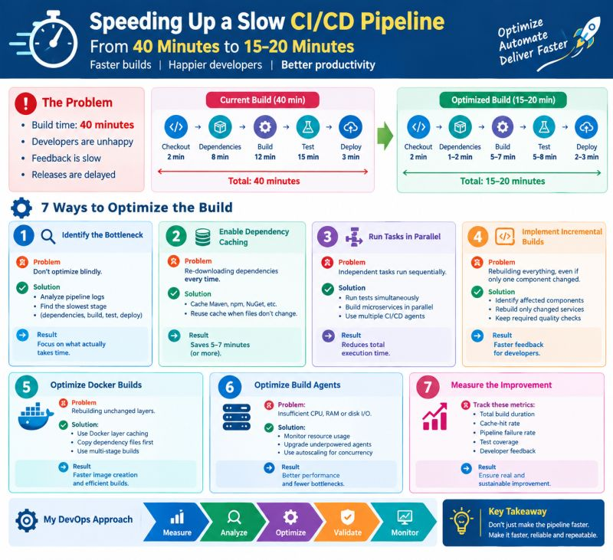
Your CI/CD Build Takes 40 Minutes. Developers Are Unhappy. How Would You Speed It Up?**
Imagine your development team pushes code, starts the CI/CD pipeline, and then waits 40 minutes for the build to finish.
Developers are frustrated. Feedback is slow. Releases are delayed.
👉 **As a DevOps Engineer, how would you solve this problem?**
Let's break it down! 👇
🔍 **1. Identify the Bottleneck**
Don't optimize blindly!
✅ Analyze pipeline logs and execution times.
✅ Identify whether the delay comes from dependency installation, compilation, testing, or deployment.
⚡ **2. Enable Dependency Caching**
Why download the same dependencies every time?
✅ Cache Maven, npm, or NuGet dependencies.
✅ Reuse cached dependencies when the dependency files haven't changed.
Result: Less downloading and faster builds.
🔄 **3. Run Tasks in Parallel**
Why execute independent tasks sequentially?
✅ Run independent test suites simultaneously.
✅ Build independent microservices in parallel.
✅ Use multiple CI/CD agents when appropriate.
Result: Reduced total pipeline execution time.
🏗️ **4. Implement Incremental Builds**
Why rebuild everything when only one component changes?
✅ Identify affected components.
✅ Rebuild only the services impacted by code changes.
✅ Avoid unnecessary compilation and testing while maintaining required quality checks.
Result: Faster feedback for developers.
Your CI/CD Build Takes 40 MinutesHow Would You Speed It Up?**

Slide 7
Your CI/CD Build Takes 40 MinutesHow Would You Speed It Up?**
🐳 **5. Optimize Docker Builds**
Docker builds can waste time rebuilding unchanged layers.
✅ Use Docker layer caching.
✅ Copy dependency files before application source code.
✅ Use multi-stage builds where appropriate.
Result: Faster image creation and more efficient builds.
🖥️ **6. Optimize Build Agents**
Sometimes, the problem isn't the pipeline configuration—it's the infrastructure.
✅ Monitor CPU, RAM, disk I/O, and network usage.
✅ Upgrade underpowered agents when necessary.
✅ Use autoscaling agents to handle concurrent workloads.
Result: Better resource utilization and fewer build bottlenecks.
📊 **7. Measure the Improvement**
Optimization doesn't end when the pipeline becomes faster.
Track:
• Total build duration
• Cache-hit rate
• Pipeline failure rate
• Test coverage
• Developer feedback
🎯 **The Goal:**
Reduce build time from 40 minutes to approximately 15–20 minutes, depending on the bottlenecks and project complexity—without compromising code quality or reliability.

Slide 8
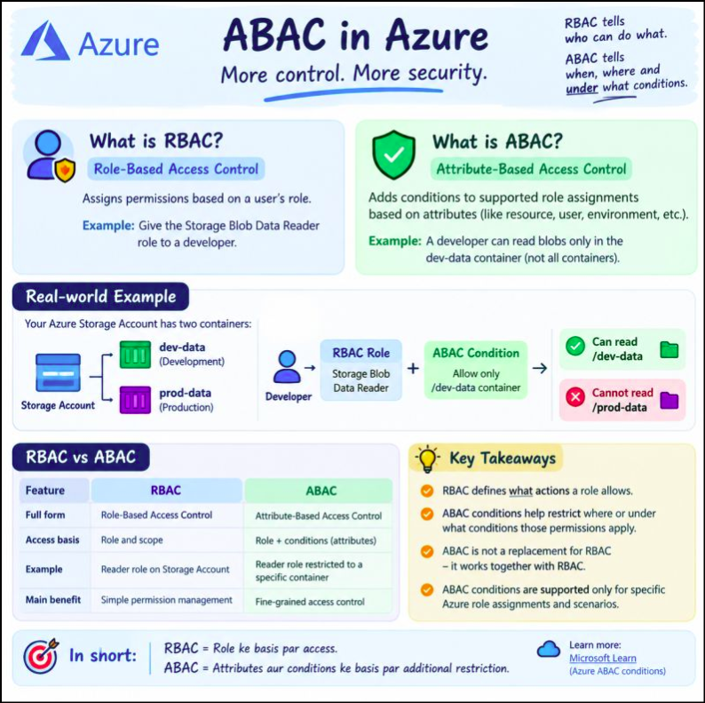
Azure RBAC vs ABAC — How Do They Work Together?

Slide 9
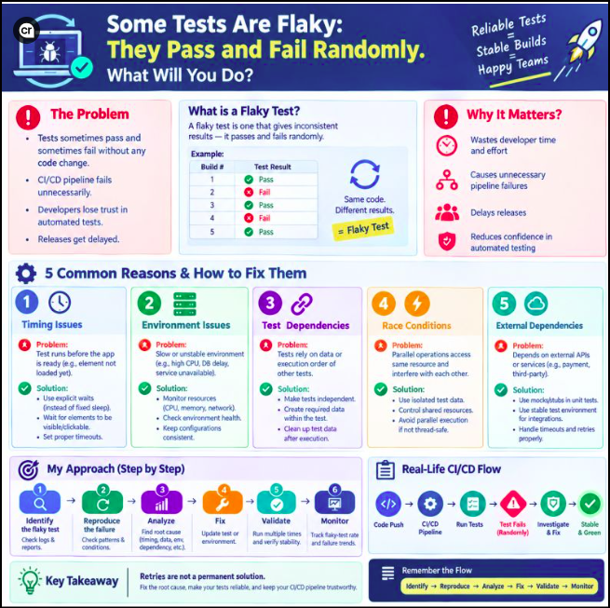
How Do You Handle Flaky Tests?
How Do You Handle Flaky Tests?
Ever seen tests pass in one build and fail in the next—with no code changes?
🤔That’s a flaky test, and it can delay releases and reduce confidence in CI/CD pipelines.
✅ Identify the root cause
✅ Analyze logs and test reports
✅ Fix timing, environment, and test data issues
✅ Validate reliability and monitor results💡
Remember: Retries are not a permanent
solution. Fix the root cause!
💬 What would you check first when a test fails randomly?

Slide 10
Azure RBAC vs ABAC — How Do They Work Together?
While learning Azure Security, I came across two important concepts: RBAC and ABAC.
Let’s understand them in simple language.
👇🔹 1. What is RBAC?RBAC stands for Role-Based Access Control.It decides what a user can do based on the role assigned to them.
💡 Example: A developer gets the Storage Blob Data Reader role to read files in Azure Storage.
🔹 2. What is ABAC?ABAC stands for Attribute-Based Access Control.It adds conditions to supported role assignments to restrict access further.
💡 Example:The developer can read files in the dev-data container but is restricted from accessing prod-data through that role assignment.
🔹 3. How Do RBAC and ABAC Work Together?Think of it this way:
✅ RBAC = Permission — What actions can the user perform?
✅ ABAC = Condition — Under what conditions can those permissions be used?
Together, they help implement more precise access control.
🎯 Real-world Azure scenario:Imagine your Storage Account has Development and Production data. You want developers to read Development data without giving them access to Production data.
You can assign the appropriate RBAC role and apply a supported ABAC condition to restrict access.🔐 This follows the Principle of Least Privilege — give users only the access they need.
📌 My key learning: RBAC and ABAC are not competitors.They can work together to improve access control and security in Azure.

Slide 11
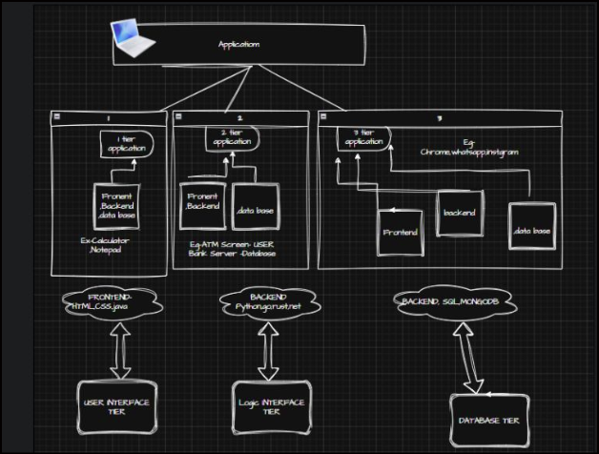
Understanding Application Tiers (1-Tier, 2-Tier, 3-Tier)
Understanding Application Tiers (1-Tier, 2-Tier, 3-Tier)
Ever wondered how the apps we use every day are actually built? Today I'm sharing something I learned and turned into a simple diagram — the basics of Application Tiers.
Application is basically made up of layers. Depending on how many layers it has, we call it 1-tier, 2-tier, or 3-tier.
1-Tier Application
Everything :frontend, backend, and database — sits together in one place.
📌 Example: Calculator, Notepad
This is Simple, but not scalable.
2-Tier Application
Application is split into two parts: Frontend + Backend on one side, and the Database on the other.
Example: ATM Screen as the user side talking to the Bank Server/Database.
3-Tier Application
This is the most common setup used in modern apps. It has three separate layers:
🔹 Frontend (what the user sees)
🔹 Backend (the logic that processes things)
🔹 Database (where data is stored)
Ex ample: Chrome, WhatsApp, Instagram
Breaking it down by skills needed:
➡️ Frontend Tier → HTML, CSS, Java
➡️ Backend Tier → Python, Go, Rust, .NET
➡️ Database Tier → SQL, MongoDB

Slide 12
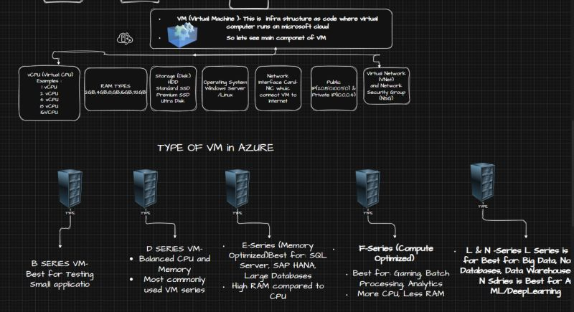
Understanding Azure Virtual Machines (VMs) – Components & Types
Understanding Azure Virtual Machines (VMs) – Components & Types
I created this visual to simplify Azure Virtual Machines (VMs).
A Virtual Machine (VM) is a cloud-based virtual computer provided by Microsoft Azure. It allows you to run Windows or Linux servers without managing physical hardware.
Key Components of an Azure VM
🖥️ vCPU – Processing power
💾 RAM – Memory for running applications
💿 Storage (Disk) – HDD, SSD, Premium SSD, Ultra Disk
🪟 Operating System – Windows or Linux
🌐 Network Interface Card (NIC) – Connects the VM to the network
🌍 Public & Private IP – External and internal communication
🔒 Virtual Network (VNet) & Network Security Group (NSG) – Secure networking and traffic control
☁️ Types of Azure VMs
B-Series – Best for Development & Testing
D-Series – General-purpose workloads (Balanced CPU & Memory)
E-Series – Memory-intensive applications like SQL Server
F-Series – Compute-intensive workloads with more CPU
L-Series – Storage-intensive workloads like Big Data
N-Series – GPU-enabled VMs for AI, ML & Deep Learning
Bonus to Remember:
Types-B Basic hai...
D Daily hai... E Extra Memory hai... F Fast CPU hai... L Large Storage hai... M Massive Memory hai... aur N? N jhukega nahi... NVIDIA GPU hai!"

Slide 13
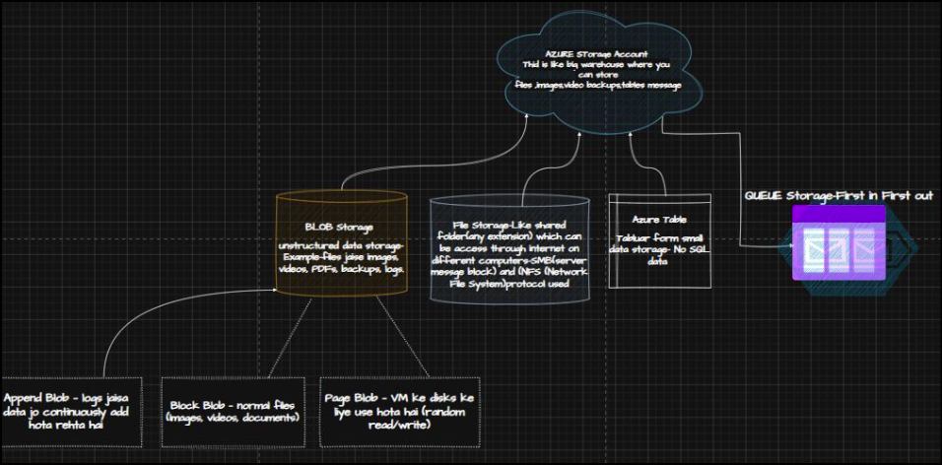
Understanding Azure Virtual Machines (VMs) – Components & Types
Spent some time today breaking down the Azure Storage Account
Think of it as one big warehouse with 4 different rooms, each built for a different kind of data.
A: Blob Storage — for unstructured data (images, videos, PDFs, backups, logs).
Types of Blog
• Block Blob → normal files
• Append Blob → logs that keep growing
• Page Blob → used for VM disks (random read/write)
B: File Storage — works like a shared network folder, accessible over the internet from different systems. Uses SMB (Server Message Block) or NFS protocol.
C: Azure Table Storage — for tabular, small-scale NoSQL data.
D: Queue Storage — First In, First Out messaging, used to connect apps/services asynchronously.

Slide 14
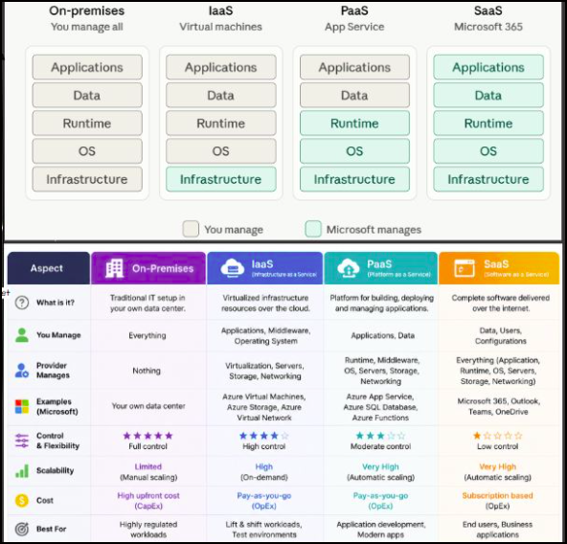
Cloud Computing: On-Premises vs IaaS vs PaaS vs SaaS
Cloud Computing: On-Premises vs IaaS vs PaaS vs SaaS
On-Premises-: Owning and running your own house.
Microsoft Azure Services :
IaaS: Renting an empty apartment—you furnish and maintain the inside.
PaaS: Renting a fully furnished apartment—bring your belongings only
SaaS: Staying in a hotel— Simply check in and use the room like a hotel
Examples: IaaS-Azure Virtual Machines (VMs)
PaaS-App Service, SQL Database.
SaaS-Microsoft Teams, OneDrive

Slide 15
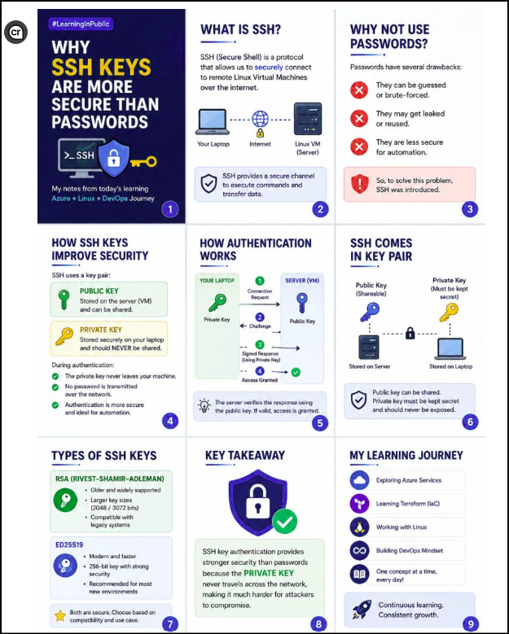
Why SSH Key Authentication is More Secure than Passwords?
SSH (Secure Shell) is a protocol that allows us to securely connect to remote Virtual Machines over the internet.
🔹 Why not use passwords?
Passwords have several drawbacks:
* They can be guessed or brute-forced.
* They may get leaked or reused.
* They are less suitable for automation.
The question is how SSH Keys improve security?
SSH uses a key pair:
1 Public Key → Stored on the server (VM) and can be shared.
2 Private Key → Stored securely on your laptop and should never be shared.
During authentication:
-The private key never leaves your machine.
-No password is transmitted over the network.
-Authentication is more secure and ideal for automation.
Common Azure SSH Key Types
A-RSA
* Older and widely supported
* Larger key sizes (2048/3072 bits)
* Compatible with legacy systems
B- Ed25519
* Modern and faster
* 256-bit key with strong security
* Recommended for most new environments

Slide 16
Terraform errors are not failures—They're Learning Opportunities
When I encountered error, every error looked scary.
Then I realised that Terraform errors are actually helpful. Most of them clearly tell you what went wrong.
Here are the most common Terraform errors every beginner should know:
1. Syntax Error
Your code has a typo or incorrect syntax.
Example: Forgot = or a closing }.
Fix: Check your code and run terraform fmt or terraform validate.
2. Missing Required Arguments
You forgot to provide a mandatory value.
Example: Creating an Azure Resource Group without specifying the location.
Fix: Add the missing required field.
3. Provider Initialization Issue
Terraform isn't ready because the provider hasn't been initialized.
Example: Running terraform plan before terraform init.
Fix: Always run terraform init when starting a new project.
4. Authentication Problem
Terraform can't connect to Azure because you're not authenticated.
Your Azure CLI session has expired.
Run az login and verify the correct subscription.
5. Incorrect Resource Reference
Terraform is trying to use a resource that doesn't exist.
Example: You created a resource named rg but referenced it as demo.
Fix: Double-check your resource names and references.
6. State-Related Conflict
Another Terraform operation is already using the state file.
Example: Two engineers run terraform apply at the same time.
Fix: Wait for the state lock to be released or resolve it safely.
SO Troubleshooting Checklist
✅ terraform fmt – Format the code
✅ terraform validate – Validate the configuration
✅ terraform init – Initialize the project
✅ terraform plan – Preview the changes
✅ terraform apply – Deploy the infrastructure
Biggest takeaway:
Don't panic when Terraform throws an error.
Read the error message carefully. In most cases, Terraform tells you exactly what went wrong and points you to the line that needs attention.
Every error you solve today makes you a better DevOps Engineer tomorrow.
What was the first Terraform error you encountered while learning?

Slide 17
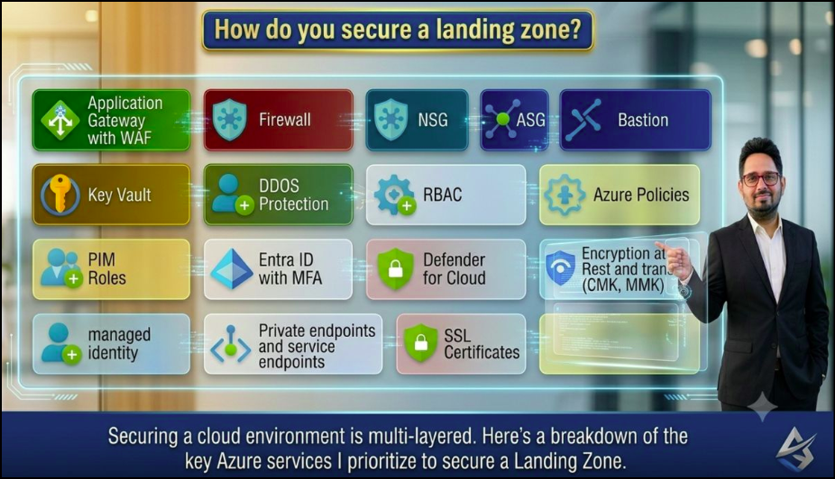
How do you secure an Azure Landing Zone?
How do you secure an Azure Landing Zone?
When designing an Azure Landing Zone, these are the security components I consider essential:
1 Application Gateway with WAF
2 Azure Firewall, NSG, ASG & Bastion
3Azure Key Vault for secrets management
4 RBAC & Azure Policy
5 Microsoft Entra ID with MFA & PIM
6 Microsoft Defender for Cloud & Microsoft Sentinel
7Managed Identity
8Private Endpoints & Service Endpoints
9 SSL Certificates
Every environment has different requirements, but these controls provide a solid baseline for improving security, governance, and operational efficiency.

Slide 18
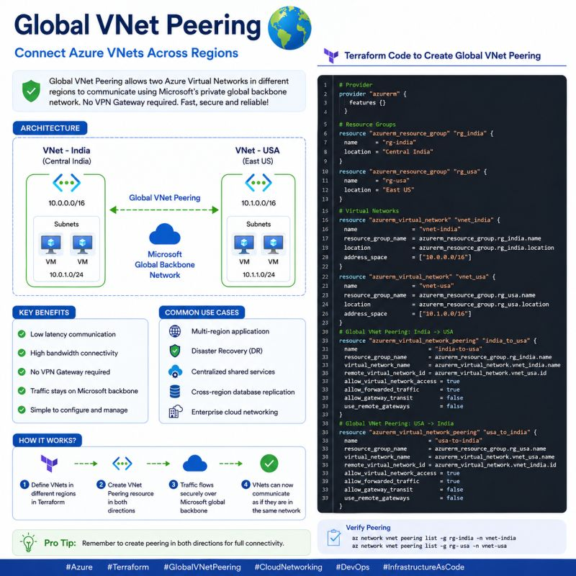
Today, something interesting about Azure Networking
Today, something interesting about Azure Networking. I always thought connecting applications running in different Azure regions would require what?. But Global VNet Peering, which allows two Virtual Networks in different regions to communicate securely over Microsoft's private backbone network—without a VPN Gateway.
Creating it using Terraform made the concept much easier to understand. Every day, I'm learning something new on my Azure and DevOps journey.
Terraform Steps:
Step 1: Load Provider
Step 2: Create Resource Group 1-
Step 3: Create Resource Group 2
Step 4: Create India VNet
Step 5: Create USA VNet
Step 6: Create First Peering
Step 7: Create Second Peering

Slide 19
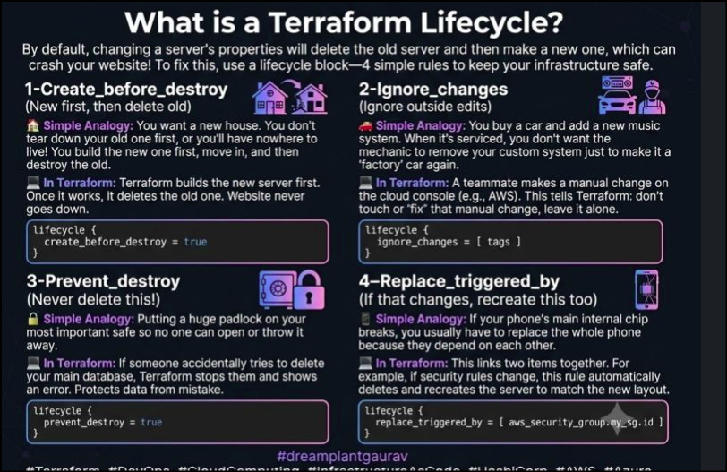
Today, something interesting about Azure Networking

Slide 20
Today, something interesting about Azure Networking
What is a Terraform Lifecycle?
By default, if you change something on a server, Terraform will delete the old server first and then make a new one. But this can crash your website!
To fix this, we use a lifecycle block. It is a set of 4 simple rules (Chacha Rest In Peace) to keep your infrastructure safe: where C (Create_before_destroy) R(replace_triggered_by) I(Ignore_changes) P(Prevent Destroy)
1-Create_before_destroy (New first, then delete old)
🏠 Simple Analogy: You want a new house. You dont tear down your old house first, or you will have nowhere to live! You build the new house first, move in, and then destroy the old one.
💻 In Terraform: Terraform builds the new server first. Once it works, it deletes the old one. This means your website never goes down.
lifecycle {
prevent_destroy = true
}
2-Ignore outside edits)Ignore_changes (
🚗 Simple Analogy: You buy a car and add a new music system to it. When you take the car for servicing, you dont want the mechanic to remove your music system just to make it look like a factory car again.
💻 In Terraform: Sometimes, a teammate changes a setting manually on the cloud console (like AWS). This rule tells Terraform: Dont touch or fix that manual change, leave it alone.
lifecycle {
ignore_changes = [ tags ]
}
3-Prevent_destroy (Never delete this!)
🔒 Simple Analogy: Putting a huge padlock on your most important safe so no one can open or throw it away.
💻 In Terraform: If someone accidentally tries to delete your main database, Terraform stops them and shows an error. It protects your most important data from being erased by mistake.
lifecycle {
prevent_destroy = true
}
4-Replace_triggered_by (If that changes, recreate this too)
📱 Simple Analogy: If your phone's main internal chip breaks, you usually have to replace the whole phone because they depend on each other.
💻 In Terraform: This links two items together. For example, if your security rules change, this rule tells Terraform to automatically delete and recreate the server so it matches the new security layout perfectly.

Slide 21
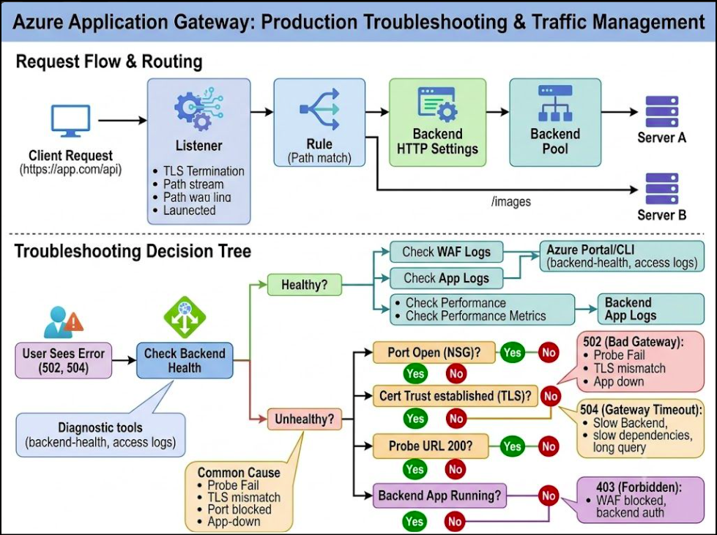
Troubleshooting Azure Application Gateway Errors:

Slide 22
Troubleshooting Azure Application Gateway Errors:
Request Flow: Production Troubleshooting. If you've ever dealt with a sudden 502 Bad Gateway or 504 Gateway Timeout in production, you know how critical it is to understand your end-to-end traffic flow!
When managing Layer 7 load balancing in Azure, looking at a visual breakdown makes all the difference. Here is a simple guide to how requests move and how to diagnose issues when things go wrong:
1:The Request Flow: Client Request: Hits the Application Gateway frontend IP/Listener (Port 443) with TLS termination. Routing Rules: Inspects hostnames and URL paths (like /api vs /images).Backend Pool amp; HTTP Settings: Forwards traffic safely to your healthy backend servers.
🛠️ Production Troubleshooting :
502 Bad Gateway (Unhealthy Backends): Don't panic or just restart! Check your Backend Health first. Look for probe timeouts, blocked Network Security Group (NSG) ports, or broken TLS trust chains.
504 Gateway Timeout:
Investigate backend latency, heavy dependencies, or long-running database queries before blindly extending timeouts.403 Forbidden: Check if your Web Application Firewall (WAF) or backend authorisation rules are blocking the request.
Pro-tip: A 200 OK health probe doesn't guarantee your core API endpoints are healthy—always correlate gateway metrics with backend app logs

Slide 23
Terraform Learning Journey | Day — Exploring Terraform CLI Commands
terraform console – Evaluate Terraform expressions interactively
Example
terraform console
> 10 + 20 # Output: 30
> "Hello" + " Terraform" # Output: "Hello Terraform"
> upper("azure") # Output: "AZURE"
> length("Terraform") # Output: 9
> exit
🔹 terraform fmt – Format Terraform configuration files.
🔹 terraform graph – Visualize infrastructure dependencies.Understand which resources Terraform creates first and how resources depend on each other.
🔹 terraform import – Bring existing infrastructure under Terraform management
🔹 terraform providers – Identify required providers
🔹 terraform show – Inspect the current state or a saved plan
🔹 terraform state – Manage Terraform state
🔹 terraform workspace – Manage separate workspaces
terraform workspace list # Lists all workspaces
terraform workspace new dev # Creates a dev workspace
terraform workspace select dev # Switches to dev workspace
terraform workspace show # Shows current workspace
terraform workspace delete dev # Deletes a workspace
🔹 terraform output – Display output values
terraform output # Displays all outputs
terraform output rg_name # Displays a specific output
terraform output -json # Displays outputs in JSON format

Slide 24

2-Terraform Learning Journey | Day — Exploring Terraform CLI Commands

Slide 25
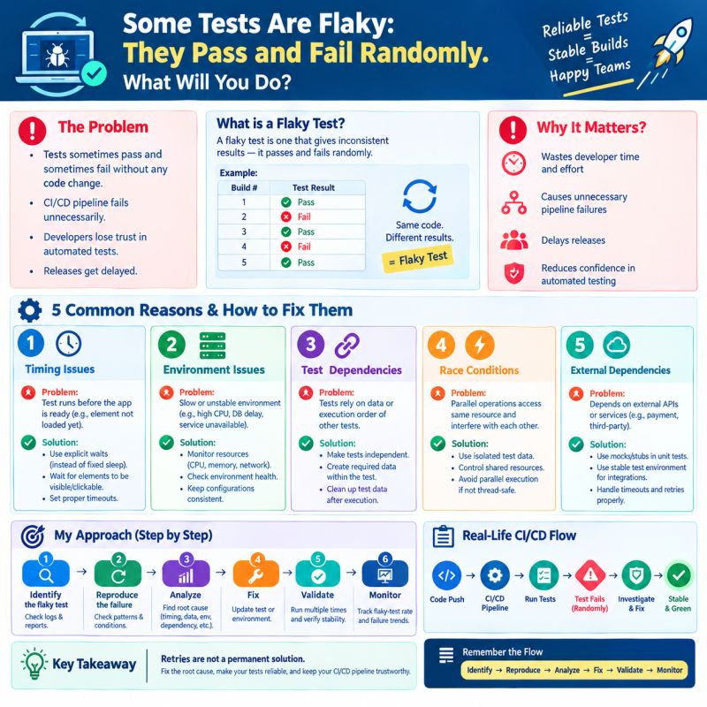
How Do You Handle Flaky Tests?
How Do You Handle Flaky Tests?
Ever seen tests pass in one build and fail in the next—with no code changes?
🤔That’s a flaky test, and it can delay releases and reduce confidence in CI/CD pipelines.
✅ Identify the root cause
✅ Analyze logs and test reports
✅ Fix timing, environment, and test data issues
✅ Validate reliability and monitor results💡
Remember: Retries are not a permanent
solution. Fix the root cause!
💬 What would you check first when a test fails randomly?

